Slide 1
How to Get the Binding Energy by Mass Spectrometry
Speaker: Tianyu Sun
Advisor: Prof. Wu
Dr. Zhang
Notes:
Good afternoon, today the title of my presentation is “how to get the binding energy by mass spectrometry”

Slide 2
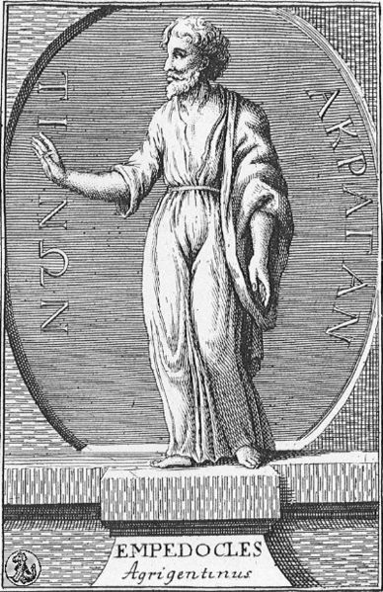
Preface
Empedocles (490–430 BC, Greek) said:
“ Love will bring about the element
hate will separate the element”
love
hate
Notes:
An ancient Greek philosopher Empedocles said: love will bring about the element, but hate will separate the element!
So we can see that it is a human instinct to study the driving force to combine and separate the matter

Slide 3
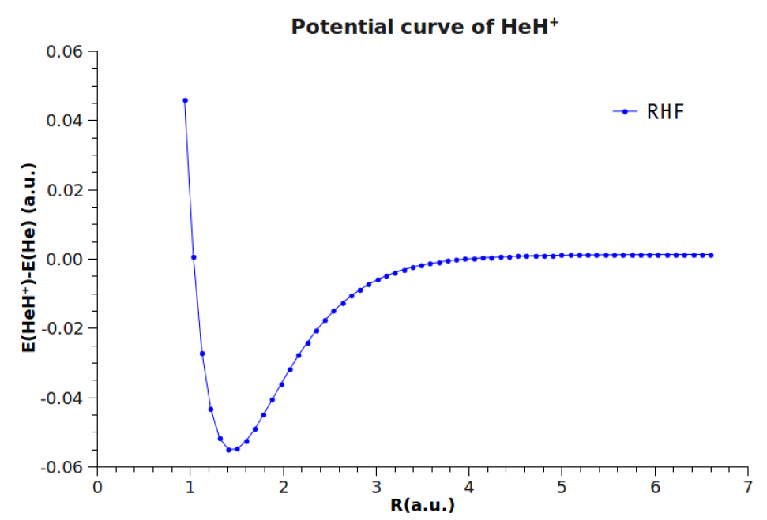
Preface
Binding energy
我做了这么久计算和有机机理，对化学理解就是“能量和电子的分配”
Notes:
When I was young, the most fundamental conception of chemistry is the binding energy, because it tells us whether a reaction can happen!
When I was a graduate student, prof. Zhang told me
So the conception of binding energy is very important

Slide 4
Preface
in organometallic reactions, the key reactive intermediates are coordinatively unsaturated transition metal–ligand complexes that have an open site by loss of one or more ligands.
These unsaturated intermediates are good catalysts because they are reactive
But transient and difficult to study
such information would enable predictions of the feasibility of desired reaction
Notes:
Concretely,in organometallic reactions, the key reactive intermediates are coordinatively unsaturated transtition metal-ligand complexes that have an open site by loss of one or more ligands.
These unsaturated intermediates are good catalysts because they are reactive
But they are transient and difficult to study
If we can acquire the binding energy, such information would enable predictions of the feasibility of desired reaction, it’s very useful!

Slide 5
Preface
The methods to get the binding energy:
photoelectron spectroscopy
Time resolved infrared spectroscopy
ion beam studies of endothermic reactions
flowing afterglow
kinetic energy release distributions
Energy resolved collision induced dissociation
1aser-powered homogeneous pyrolysis
guided ion beam mass spectrometry
Quantum chemistry……
Notes:
There are many methods can get the binding energy, and most of them are carried out in gas-phase,
Although gas-phase chemistry cannot provide accurately data of binding energy
It can still provide the useful information.
I only know the mechanism of this two methods, today I will introduce this methods

Slide 6
Outline
Kinetic theory of gases
maxwell speed distribution
Classic Collision Theory
cross section
Determination of cross section by MS
threshold energy (阈能)
Determination of Binding Energy
Doppler broadening
the relative velocity distribution
the models of cross section
Equipment
ion beam energy
guided ion beam
pressure
Future work
summary
Notes:
This is the outline
Firstly, I will introduce the kinetic theory of gases, because the MS experiment, the reactants are in the gas phase, so their movement obey the law of kinetic theory of gases, it includes maxwell speed distribution, It will be used to deduce the relative velocity distribution, then the classic collision theory, it will introduce the conception of cross section, the conception is very important because it is related to the threshold energy for determination Binding energy.the next part is determination of binding energy, when the energy of ion beam is low, we must conside the doppler broadening, we need to get the relative velocity distribution
And our purpose is to get BE using our own equipment, I will compare our MS with other groups in this three aspect
Finally, the future work and summary

Slide 7
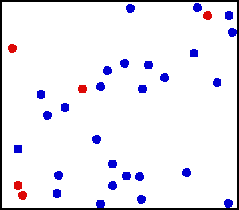
kinetic theory of gases
Ideal gas
maxwell velocity distribution
the number of particles with velocity between
and + in per unit volume
Often we more care about speed, no velocity!
v
maxwell speed distribution
v+dv
Notes:
Kinetic theory of gases
For ideal gas, their velocity obey the maxwell velocity distribution
But we often more care about the speed, not the velocity!
And this is the maxwell speed distrubtion, we mutiply the shell to this, and we get the distribution

Slide 8
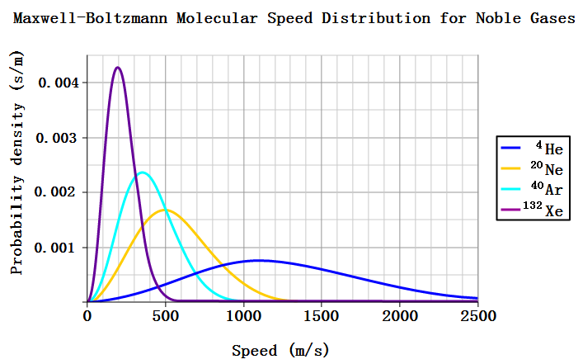
kinetic theory of gases
maxwell speed distribution
Notes:
This is the curve of maxwell speed distribution

Slide 9
Classic Collision Theory
u_{r}
θ
B
A
d_{AB}
b
d_{AB}=r_{A}+r_{B}
u_{r} is the relative speed between particle A and particle B
μ is the reduced mass
ε_{c} is the threshold energy, if ε’_{r} > ε_{c}, the reaction can happen!
Notes:
Now the classic collision theory
The ideal gas move in the gas cell
For two molecules, If The distance between their center of mass, then they will collide with each other
Ur is the relative speed between particle A and particle B
εr is the relative kinetic energy between them, μ is the reduced mass
but we more care about the relative kinetic energy along the their center of mass, just mutiply cos, we can get it ,if this energy larger than threshold energy, the reaction can happen!

Slide 10
Classic Collision Theory
u_{r}
θ
B
A
d_{AB}
b_{r} :reaction radius
b
define σ_{r} the reaction cross section
quantum states
Notes:
when εr equals εc, for convenient, we define the reaction radius,if b is smaller than br, the reaction can happen, according to the br,we also define sigma r, the reaction cross section, it has the form like this,
If we get sigma r ,we can get the threshold energy, using the threshold energy we can get the binding energy! but this is a classic picture, it’s very easy to understand, actually, sigma r includes many quantum effect.
Using mass spectrometer can get sigma r.

Slide 11
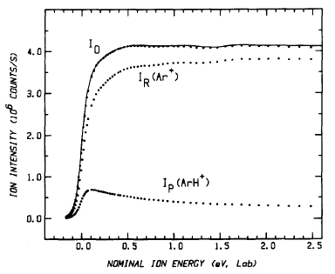
Determination of cross section by MS
Using mass spectrometer can get the Ion intensities for reaction
gas cell
Ip(ArH⁺)
Mass
spectrometer
+
+
+
+
+
+
+
+
+
I₀
+
+
+
I_{R}(Ar⁺)
At a low pressure
Just single collison
P. B. Armentrout ,J. Chern. Phys., 83, 166 (1985)
Notes:
Using mass spectrometer can get the Ion intensities for reaction
for example, the argon ion can react with hydrogen molecule to form this product ion in the gas cell, the pressure in the gas cell must be very low to insure the single collison, the MS can measure I0,Ir,Ip

Slide 12
Determination of cross section by MS
at low pressure, just single collison
first order reaction
l is the effective path length
n is the density
nl
t
σ_{tot}
k₁
Notes:
we suppose that at low pressure, just single collison, so it is the first order reaction, and this is the expression of first order reaction
The reaction rate is only proportional to the concentration of the reactant.it has a exponent form, for MS, the ion intensities can also be written in this way. l is the effective path length, n is the density

Slide 13
Determination of cross section by MS
At low pressure
Taylor expansion
I_{R}≈(I_{R}+ΣI_{P})(1- σ_{tot}nl)
Individual product cross sections σ_{p}
σ_{p}→ threshold energy
Notes:
at low pressure, this term is very small, according to the taylor expansion, we only take the first two term
and because I0 equals Ir+Ip, the individual product cross sections equals this, so it can be convert to this form, from sigma p, we can get threshold energy

Slide 14
Determination of Binding Energy
gas cell
gas cell
high ion beam energy
low ion beam energy
E_{lab}»kT
E_{lab}<kT
high
low
+
+
+
+
+
+
+
+
target molecule: stationary
target molecule: Doppler broadening
the σ is a function of E_{lab}
the relative velocity is important
Notes:
but there is a serious problem when we calculate the cross section .
when the ion beam energy is high, the target molecule in the gas cell can be considered as stationary
but when the ion beam energy is low, the target molecule can not be seen as stationary any more, we must consider it thermal velocity,
so the cross section is a function of ion beam energy

Slide 15
Determination of Binding Energy
how to get the relative velocity?
M
target molecule
m
V
v(cm)
v
center of mass(cm)
M
Vcm
V₀(cm)
m
monoenergetic ion beam
V₀
if v=0
E₀ is nominal center of mass energy
Notes:
how to get the relative velocity
for example, the monoenergetic ion beam with velocity V0 has the mass m, move in this direction
the target molecule with velocity v, the mass M, move in this direction, they will encounter at this point.
we can also consider this two as a system,the center of mass move with the velocity Vcm
approach each other with velocity V, and the center of mass with velocities V(cm) and Vo(cm),respectively.
the V0(cm) and v(cm) and V have this three relationship
we can get the relative kinetic energy E, if v=0, E0 is nominal center of mass energy, it has no physical meaning, just for convenient

Slide 16
Determination of Binding Energy
the thermal distribution of v gives rise to a distribution of V
velocity space
ρ: the volume of the red area to the volume of the whole shell of radius v
dV₀
dv
V
v
V₀
V₀+V
θ
V₀-V
G. J. SCHULZT, PHYS.REV., 32, 110 (1954).
Notes:
the thermal distribution of v gives rise to a distribution of V
if V is fixed, according to the velocity space, the v only in the red area can make the particles encounter,
ρis the volume of the red area to the volume of the whole shell of radius v
brother Chenyang help me to deduce the expression
the v can have value from V0-V to V0+V,

Slide 17
Determination of Binding Energy
the ratio of particles with relative velocity between V and V+dV
Notes:
the ratio of particles with relative velocity between V and V+dV
the distribution of the speed of gas is maxwell speed distribution

Slide 18
Determination of Binding Energy
integration gives:
It is convenient to introduce the parameters
Notes:
the v can have value from V0-V to V0+V,
the integration gives this equation
and it is convenient to introduce the three parameters
and the equation is briefly converted to this form. can also be written like this

Slide 19
Determination of Binding Energy
relative kinetic energy disturbution
convolution of σ(E)
σ_{app}(E₀) is the apperent reaction cross section
The (E/Eo)^{1/2} factor accounts for the difference in the residence times of ions in the interaction region at different ion energies.
gas cell
low ion beam energy
E_{lab}<kT
low
+
+
+
+
target molecule: Doppler broadening
P. B. Armentrout ,J. Chern. Phys., 83, 166 (1985)
Notes:
with this relative kinetic energy disturbution in hand, we can carry out convolution of cross section all over the distribution.
σ_{app}(E₀) is the apperent reaction cross section, It can be obtain by the MS
The (E/Eo)^{1/2} factor accounts for the difference in the residence times of ions in the interaction region at different ion energies.
it is easy to understand because the high speed particle will pass the gas cell with shorter time
so with this equation, we can handle low ion beam energy condition

Slide 20
Determination of Binding Energy
σ(E) is a function of threshold energy
classic
quantum
the models of σ(E):
Exponential Cross Section
Linear Cross Section
Inclined Step-Function Cross Section
Step-Function Cross Section
Notes:
the final step, if we know the specific form of cross section as a function of threshold energy
we can use calculation the cross section,
we have mentioned early that the classic picture has this function form, and the quantum picture has this form, and there are many of other models,
but the mostly popular model is the quantum model

Slide 21
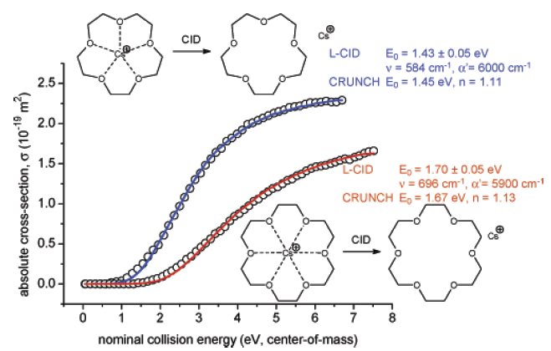
Determination of Binding Energy
σ₀ is a scaling factor
E the relative kinetic energy
n an adjustable parameter
quantum states
(vibrational, rotational, and electronic)
with energies Ei and populations gi
The σ0, n, and E0 parameters are fitted by least squares analysis
E₀ is nominal center of mass energy
CRUNCH L-CID
Peter Chen, J. Phys. Chem. A, Vol. 111, No. 30, 2007

Slide 22
Determination of Binding Energy
threshold energy
there are three types of reaction used to determine the binding energy of M+–L
Notes:
a little summary, when the ion beam energy is low ,because the thermal movement of the gas, the

Slide 23
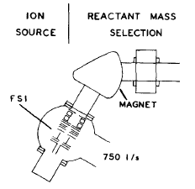
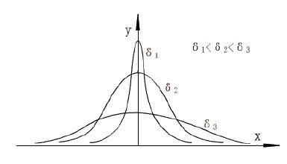
Equipment
monoenergetic ion beam
V₀
The energy spread of E_{lab} need to be very narrow
Because the cross section is a funtion of energy
gas cell
E_{lab}
+
+
+
+
momentum analyzer serves to narrow the energy spread
The narrower , the better
P. B. Armentrout ,J. Chern. Phys., 83, 166 (1985)
Notes:
we suppose the ion beam is monoenergetic to deduce the equation.
so in experiment, the energy spread of Elab need to be very narrow because the cross section is a funtion of energy
other groups’equipments have momentum analyzer serves to narrow the energy spread
but our equipment don’t have this model,
that’s a problem

Slide 24
Equipment
The scattering can reduce the signal
+
detector
+
So we need to trap the ionic products regardless of scattering angle.
+
detector
+
+
+
Notes:
another serious problem is when a collision happened, the scattering can reduce the signal
so we need to trap the ionic produects regardless of scattering angle to the center line

Slide 25
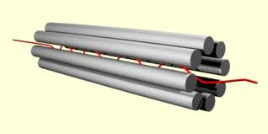
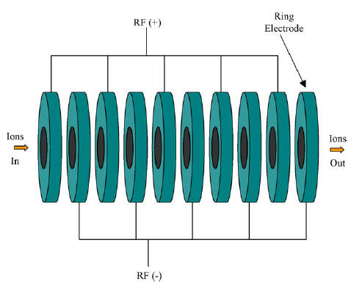
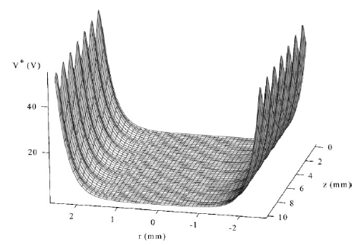
Equipment
Using octopole to trap the ion
Travelling wave (T-wave) ion guide
adjacent rings have opposite phases of radio frequence voltage
the effective potential
Notes:
usually, people use octopole to trap the ion ,this is the effective potential, it can form a potential well
our equipment is using Travelling wave (T-wave) ion guide, it’s structure is like this,
so our equipment can carry out the ion guide

Slide 26
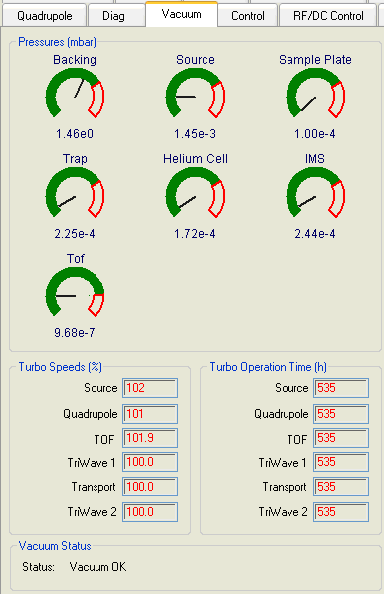
Equipment
At a low pressure, Just single collison
gas cell
+
+
+
+
2.25e-2 Pa
Pressures 6.5e-6 Pa can be used for cross section measurements.
Notes:
another serious problem is the pressure, the pressure must be very low to insure the single collison,

Slide 27
Future research
Pd II-Catalyzed Enantioselective Activation of C(sp2)-H and C(sp3)-H Bonds Using Monoprotected Amino Acids as Chiral Ligands
Yu, J.-Q. Angew. Chem. Int. Ed. 2008, 47, 4882.)

Slide 28
Summary
Determination of Binding Energy
threshold energy
Equipment

Slide 29
Thanks for your attention

